Slide 1
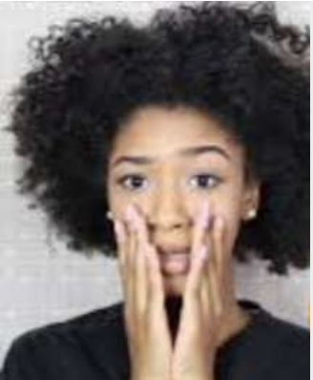


What hair products should I use for my curls?
By Fatima Loumaini
floumaini
Fatima Loumaini

Slide 2
60 % of the world population has curls, coils or waves
Curls are like snowflakes in the winter, they are different and so are the products to use for each type.
Hair types are broken up to 4 main groups and each group is divided in 3 subcategories:
Type 1: Straight ( 1a, 1b, 1c)
Type 2: Wavy( 2a, 2b, 2c)
Type 3: Curly( 3a, 3b, 3c)
Type 4: Coily( 4a, 4b, 4c)

Slide 3
Knowing the curl hair type is just the beginning of the journey
4 years ago a hairdresser in Seattle changed my hair routine forever by telling me my curl hair type.
Following this discovery, finding the right products to use was much easier.
In general, finding the best hair routine takes several trials.

Slide 4
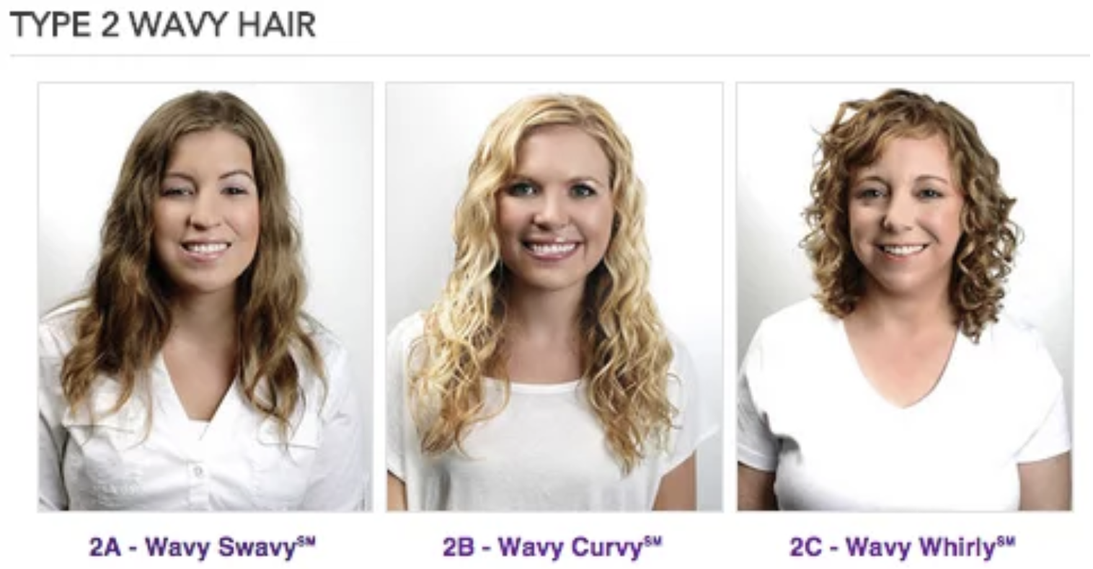
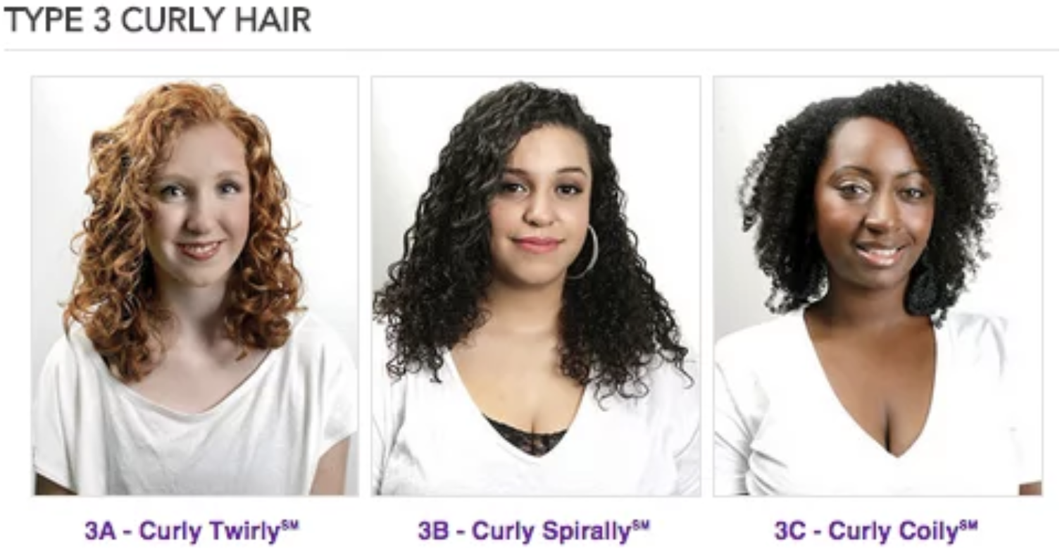
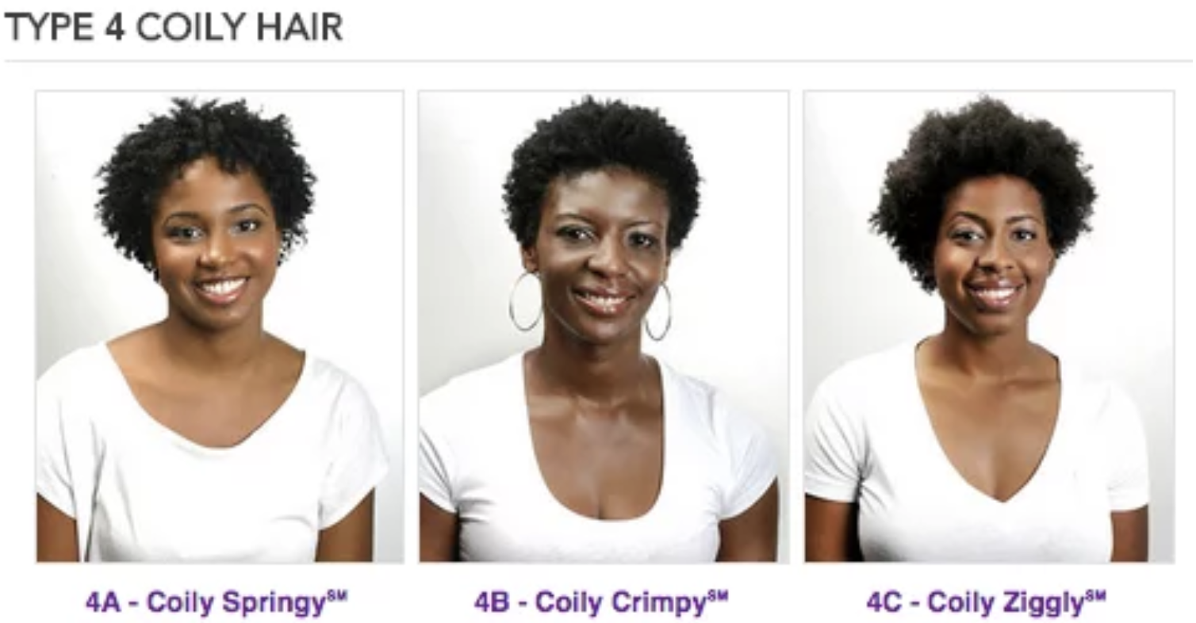
Project at a glance
This project aim to train a model that recognizes the hair types subcategories of type 2, 3 and 4 using labeled example images for 9 classes.
Help customers find the right products to use for their curl hair type.
Source: Buzzfeed

Slide 5
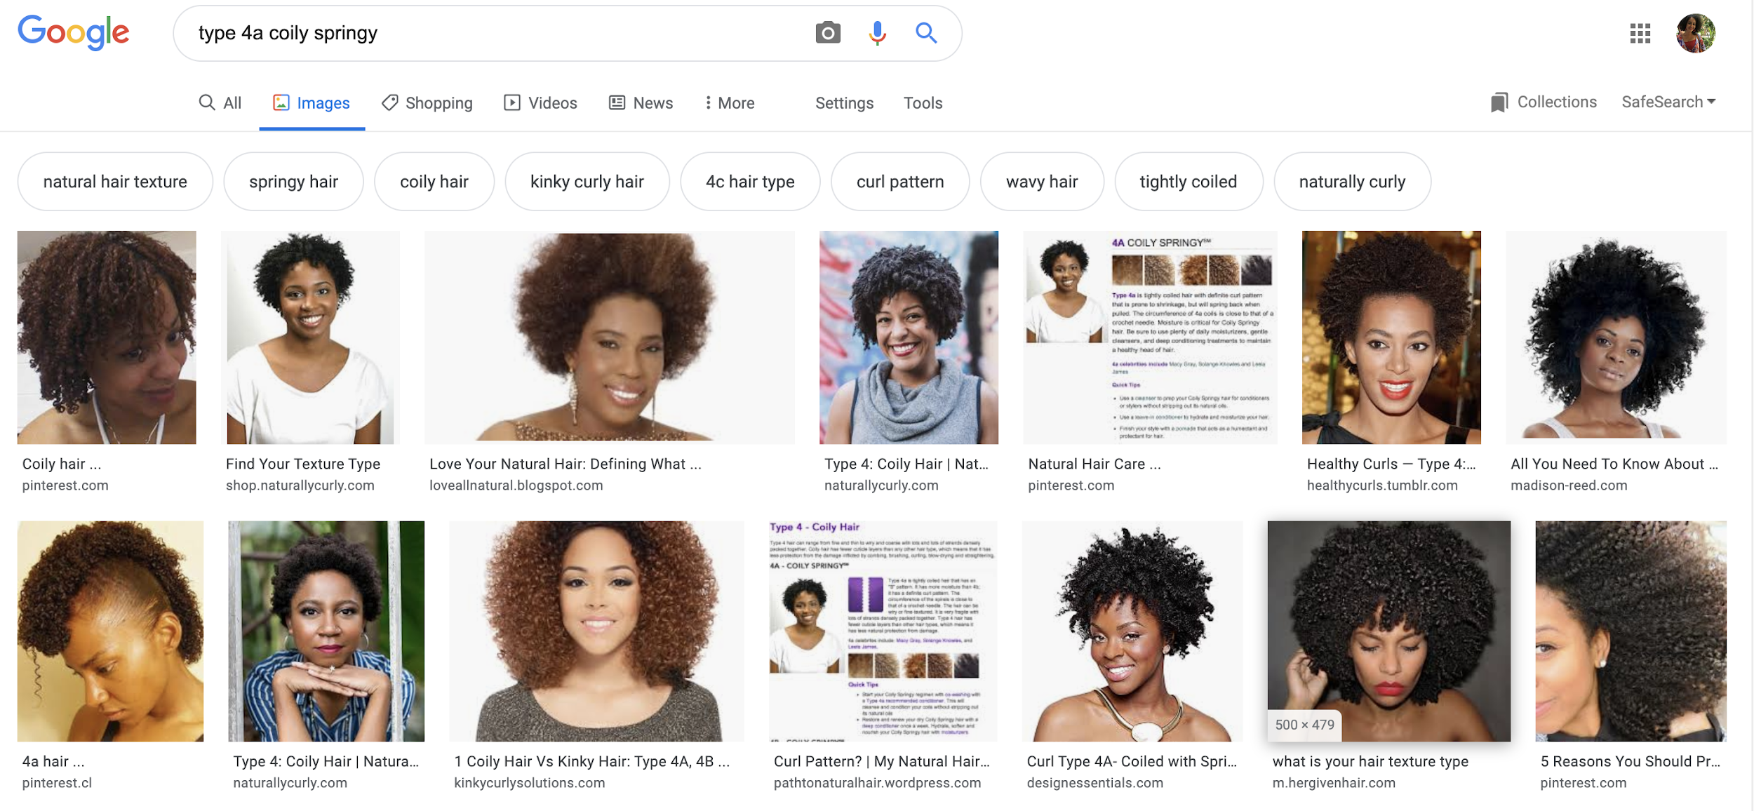
Dataset
Data scraped from Google images and other targeted website for curly hair products
Manually classified 1000+ training data images into 9 classes ( 2a through 4c).

Slide 6
Methodology: Convolutional Neural Networks
Used Convolutional Neural Network that takes the image’s raw pixel data as an input, learns how to extract these features, and ultimately infer what object they constitute. For example:
Source: becominghuman.ai

Slide 7
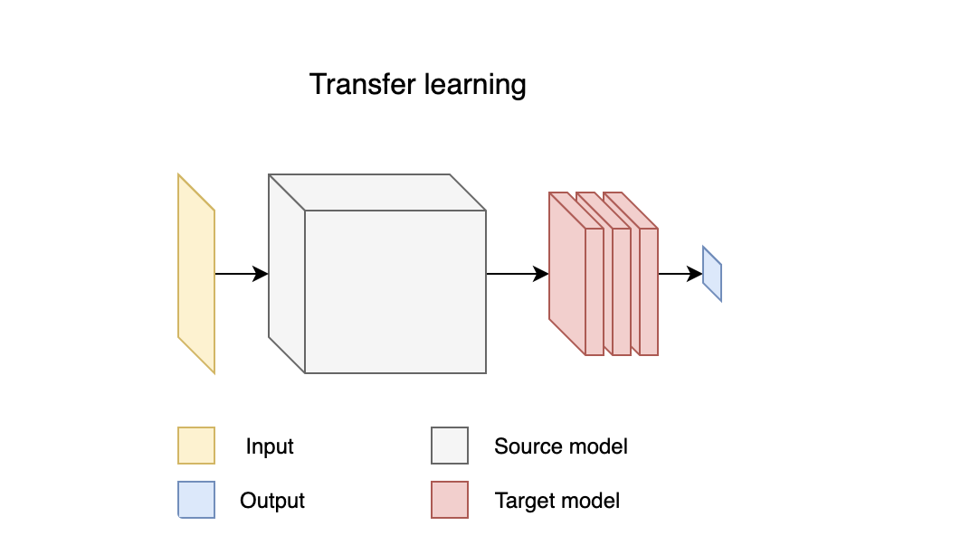
Leveraging pre-trained models: Transfer Learning
Training a CNN to perform an image classification task typically require an extremely large amount of training data (1M +).
Used MobileNet a light weight deep network best suited for embedded vision applications.
Source: mgechev
Notes:
Extracted features of MobileNet and used them as an input for the hair types classifier model.o
Fine tuned the pre-trained model and the fully connected regression layer on top to fit the business need.f M
obileNet and used them as an input for the hair types classifier model.
Fine tuned the pre-trained model and the fully connected regression layer on top to fit the business need.

Slide 8
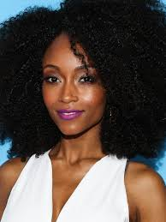
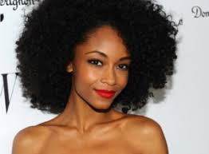
Results
Mean absolute error used as a metric to evaluate the model instead of accuracy:
MAE of 1.1 ( error of ±1 class of the true hair type)
It is very common to have variante type of curls in the same head/image.
True Class: 4A
Predicted Class: 4A
True Class: 4A
Predicted Class : 3C

Slide 9
What’s next?
We can know identify the curl hair type based on an image.
Is there a company that specializes in curly hair products and helps customers find the right products to use?
Curlbox to the rescue.

Slide 10
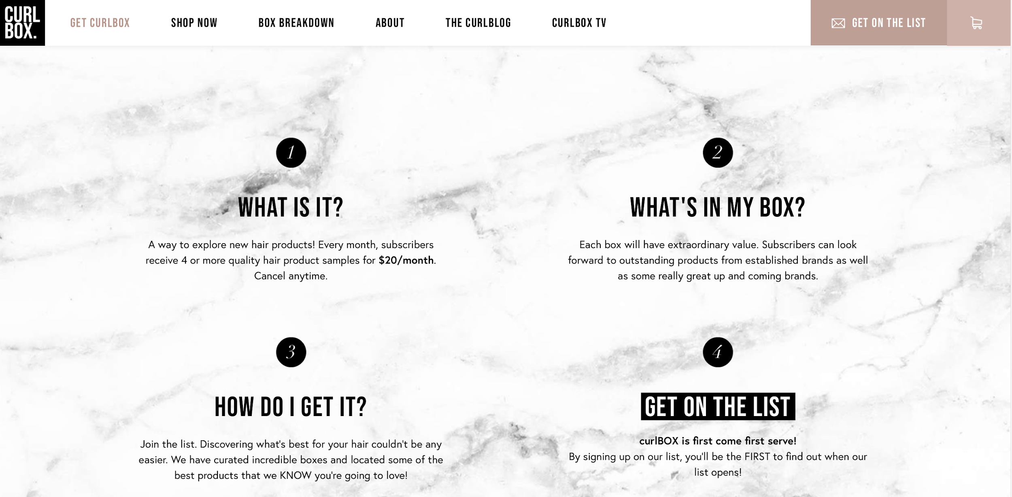
Curlbox
A web-based monthly subscription service that offers natural curly hair care products.
Curlbox can benefit from the curl hair types classifier model:
Better products customization
Higher customer satisfaction
Higher customer retention

Slide 11
Can the same methodology serve other industries?
Deep learning models are by default data hungry. A bigger dataset will lead to better results.
The methodology on this project is used on other image recognition tasks in the industry. Just to name few examples:
Healthcare: For blind and visually impaired people, Patient Radiology Data.
Security Industry: Protecting private property from intruders.
Retail: Catching physical information from the shelves and convert it to reliable and actionable data.

Slide 12
Thank you
Fatima Loumaini
floumaini
Fatima Loumaini

